Slide 1
Cloud Adoption Framework Enterprise Scale Landing Zone
Implementation Phase
Presenter Name
Presenter Role
Presenter E-mail

Slide 2
Conditions and Terms of Use
Microsoft Confidential
This training package is proprietary and confidential and is intended only for uses described in the training materials. Content and software is provided to you under a Non-Disclosure Agreement and cannot be distributed. Copying or disclosing all or any portion of the content and/or software included in such packages is strictly prohibited.
The contents of this package are for informational and training purposes only and are provided "as is" without warranty of any kind, whether express or implied, including but not limited to the implied warranties of merchantability, fitness for a particular purpose, and non-infringement.
Training package content, including URLs and other Internet Web site references, is subject to change without notice. Because Microsoft must respond to changing market conditions, the content should not be interpreted to be a commitment on the part of Microsoft, and Microsoft cannot guarantee the accuracy of any information presented after the date of publication. Unless otherwise noted, the companies, organizations, products, domain names, e-mail addresses, logos, people, places, and events depicted herein are fictitious, and no association with any real company, organization, product, domain name, e-mail address, logo, person, place, or event is intended or should be inferred.
Copyright and Trademarks
© 2019 Microsoft Corporation. All rights reserved.
Microsoft may have patents, patent applications, trademarks, copyrights, or other intellectual property rights covering subject matter in this document. Except as expressly provided in written license agreement from Microsoft, the furnishing of this document does not give you any license to these patents, trademarks, copyrights, or other intellectual property.
Complying with all applicable copyright laws is the responsibility of the user. Without limiting the rights under copyright, no part of this document may be reproduced, stored in or introduced into a retrieval system, or transmitted in any form or by any means (electronic, mechanical, photocopying, recording, or otherwise), or for any purpose, without the express written permission of Microsoft Corporation.
For more information, see Use of Microsoft Copyrighted Content at http://www.microsoft.com/about/legal/permissions/
Microsoft®, Internet Explorer®, Outlook®, SkyDrive®, Windows Vista®, Zune®, Xbox 360®, DirectX®, Active Directory®, Windows Server® and Windows® are either registered trademarks or trademarks of Microsoft Corporation in the United States and/or other countries. Other Microsoft products mentioned herein may be either registered trademarks or trademarks of Microsoft Corporation in the United States and/or other countries. All other trademarks are property of their respective owners.

Slide 3
Introductions, Objectives and Agenda

Slide 4

Introductions
Please introduce and give some background about yourself:
Your name
Your role
Current projects and/or activities you’ve been working on
What you want to get out of this session

Slide 5
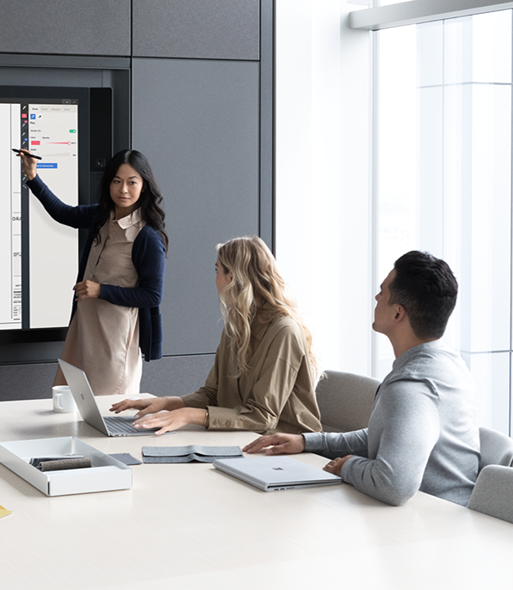
Objectives
In this engagement we will:
Implement the Enterprise-scale Reference Architecture in compliance with Customer’s requirements
Implement one of the Reference Implementations
Implement the necessary Landing Zones for applications in Azure

Slide 6
Agenda
Design Workshop
Day 1
Day 2 to 4
Day 5
Migrate Workloads
1
2
3
4
5
Implement Design Workshop architecture decisions (Limited Scope)
Enterprise Enrolment & Azure AD Tenants
Review Final Design Document
Identity & Access Management
Prerequisites
(Enterprise Enrolment, Subscriptions, Admin elevation)
Deploy the Foundation Reference Implementation
Management Group & Subscription Organization
Network Topology & Connectivity
Closeout
Management & Monitoring
Business Continuity & Disaster Recovery
Security, Governance & Compliance
Platform Automation & DevOps (Optional – Highly Recommended)
Deployment model
Azure Portal (manually)
Azure Templates Portal Based deployment (automated)
Azure Portal (manually)

Slide 7
1 - Review Final Design Document
Reviewing Assessment and Design Workshop documents

Slide 8
2 - Prerequisites
Configuring Enterprise Enrolment, Create Subscriptions and elevate AdminUser

Slide 9
Pre-requisites
Create/Organize Departments and Accounts according to the Design Workshop decisions
https://docs.microsoft.com/en-us/azure/cost-management-billing/manage/ea-portal-get-started
Create Azure Subscriptions
https://docs.microsoft.com/en-us/azure/cost-management-billing/manage/create-subscription
Configure Azure permissions for ARM tenant deployments
https://github.com/Azure/Enterprise-Scale/blob/main/docs/EnterpriseScale-Setup-azure.md

Slide 10
Implementation steps
Getting Started
https://github.com/Azure/Enterprise-Scale/blob/main/docs/Deploy/getting-started.md
Configure Azure permissions
https://github.com/Azure/Enterprise-Scale/blob/main/docs/Deploy/setup-github.md
Initialize Git with current Azure configuration
https://github.com/Azure/Enterprise-Scale/blob/main/docs/Deploy/discover-environment.md
Deploy your own ARM Templates with AzOps GitHub Actions (Optional)
https://github.com/Azure/Enterprise-Scale/blob/main/docs/Deploy/deploy-new-arm.md
Configure Azure DevOps support (Optional – Preview)
https://github.com/Azure/Enterprise-Scale/blob/main/docs/Deploy/setup-azuredevops.md

Slide 11
3 - Deploy Reference Implementation
Implementing Platform Management, Connectivity and Landing Zone

Slide 12
Reference Implementation – Foundation Scenario
Deployment
Scenario
Options
Add-On
Portal and ARM Template Based Deployment
Foundation
(Cloud Only)
Platform Management
Landing Zone
Landing Zone

Slide 13

Foundation Scenario - Implementation steps
Make sure to complete the Prerequisites
https://github.com/Azure/Enterprise-Scale/blob/main/docs/reference/wingtip/README.md
Click the button

Slide 14
Reference Implementation Scenarios
Select one Scenario based on the Design phase decisions.
Deployment
Scenarios
Options
Portal and ARM Template Based Deployment
Connectivity
Hub and Spoke
Platform Management
Connectivity
Landing Zone
Landing Ze
Connectivity
Virtual Wan
Platform Management
Connectivity
Landing Zone
Laning Zone

Slide 15
Implementation steps
Hub and Spoke Vnet
Make sure to complete the Prerequisites
https://github.com/Azure/Enterprise-Scale/blob/main/docs/reference/adventureworks/README.md
Click the button
OR
Virtual WAN
Make sure to complete the Prerequisites
https://github.com/Azure/Enterprise-Scale/blob/main/docs/reference/contoso/Readme.md
Click the button

Slide 16
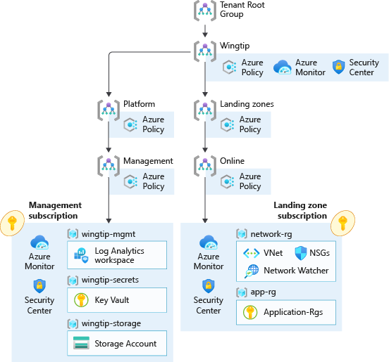
Enterprise-Scale
In Scope
A scalable Management Group hierarchy aligned to core platform capabilities, allowing you to operationalize at scale using centrally managed Azure RBAC and Azure Policy where platform and workloads have clear separation Azure Policies that will enable autonomy for the platform and the landing zones. An Azure subscription dedicated for management, which enables core platform capabilities at scale using Azure Policy such as: A Log Analytics workspace and an Automation account Azure Security Center monitoring Azure Security Center (Standard or Free tier) Azure Sentinel Diagnostics settings for Activity Logs, VMs, and PaaS resources sent to Log Analytics A landing zone subscription for Azure native, internet-facing applications and Resources, and specific workload Azure Policies such as: Enforce VM monitoring (Windows & Linux) Enforce VMSS monitoring (Windows & Linux) Enforce Azure Arc VM monitoring (Windows & Linux) Enforce VM backup (Windows & Linux) Enforce secure access (HTTPS) to storage accounts Enforce auditing for Azure SQL Enforce encryption for Azure SQL Prevent IP forwarding Prevent inbound RDP from internet Ensure subnets are associated with NSG

Slide 17
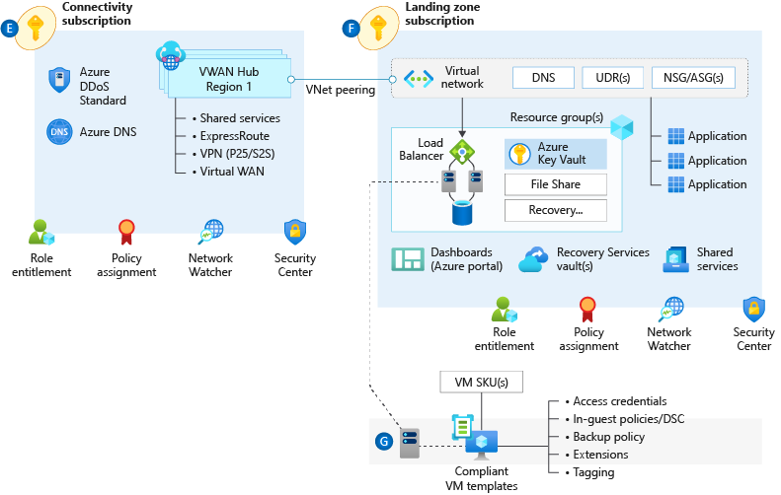
Connectivity – Virtual WAN (optional)
In Scope
An Azure subscription dedicated for connectivity Virtual WAN VWAN Hub Single region VPN Gateway (Optional) Express Route Gateway (Optional) Azure Firewall (Optional) vNET peering Azure DDoS Protection (Optional) Azure Policies assignment Prevent IP forwarding Prevent inbound RDP from internet Ensure subnets are associated with NSG

Slide 18
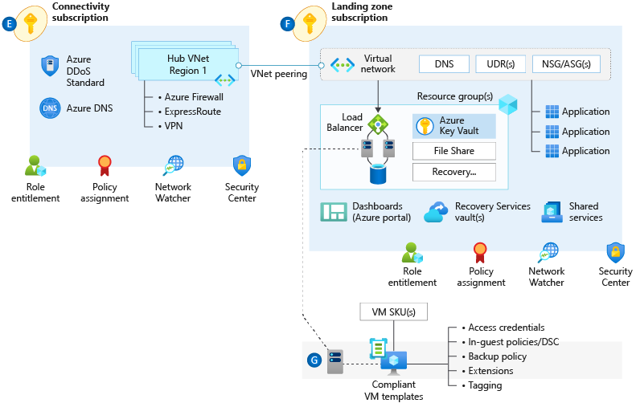
Connectivity – Hub & Spoke (optional)
In Scope
An Azure subscription dedicated for connectivity Virtual Network Hub vNET Single region VPN Gateway (Optional) Express Route Gateway (Optional) Azure Firewall (Optional) vNET peering Azure DDoS Protection (Optional) Azure Policies assignment Prevent IP forwarding Prevent inbound RDP from internet Ensure subnets are associated with NSG

Slide 19
4 - Closeout
Discussing Enterprise Scale implementation results and next steps

Slide 20
Implementation Results
<Customized Visio Diagram Goes Here>

Slide 21
Recommended Next Steps
Well-Architected Go-Live Assessment (optional)

Slide 22

Questions?

